Slide 1

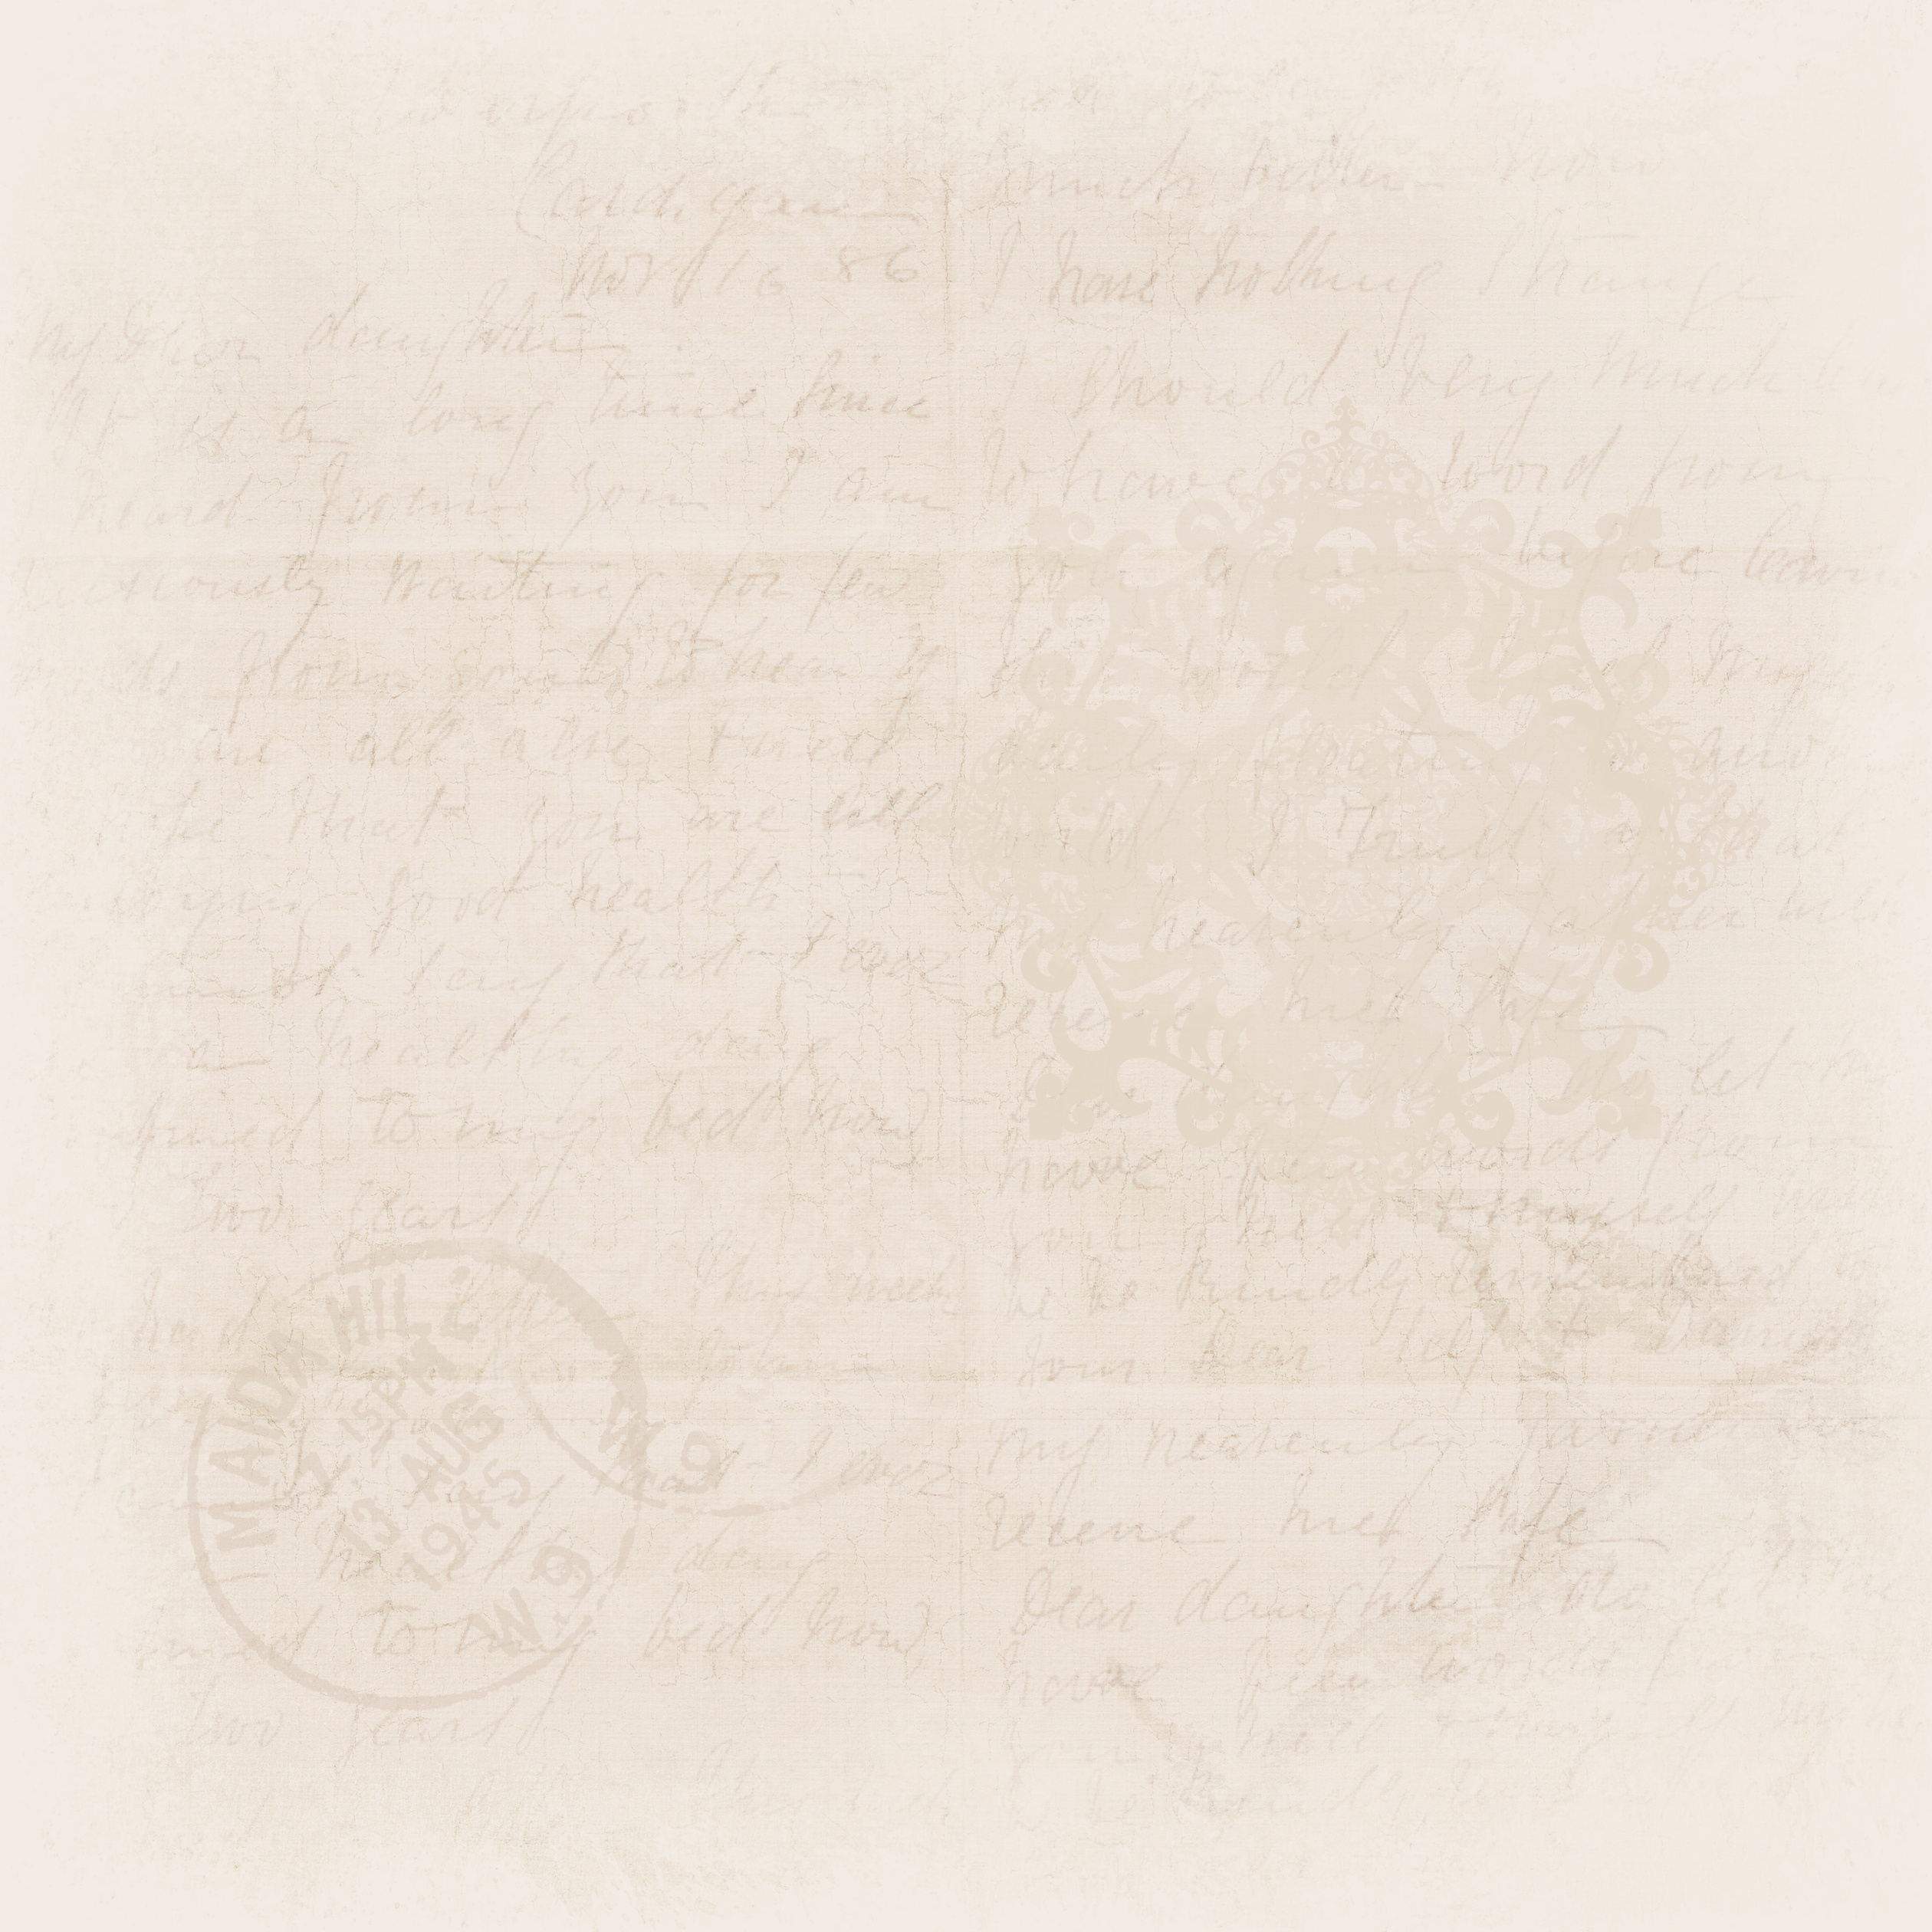

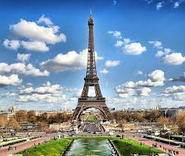


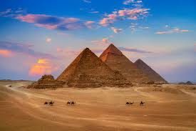
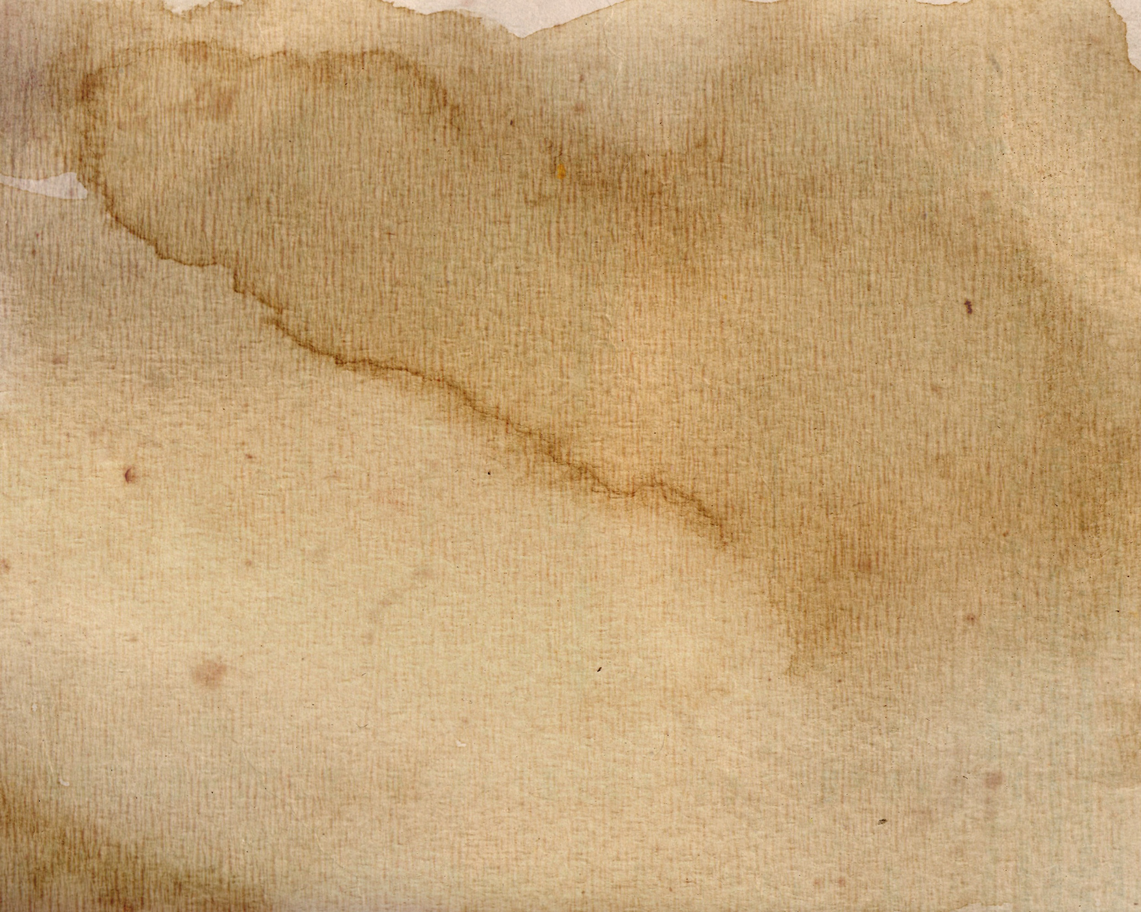
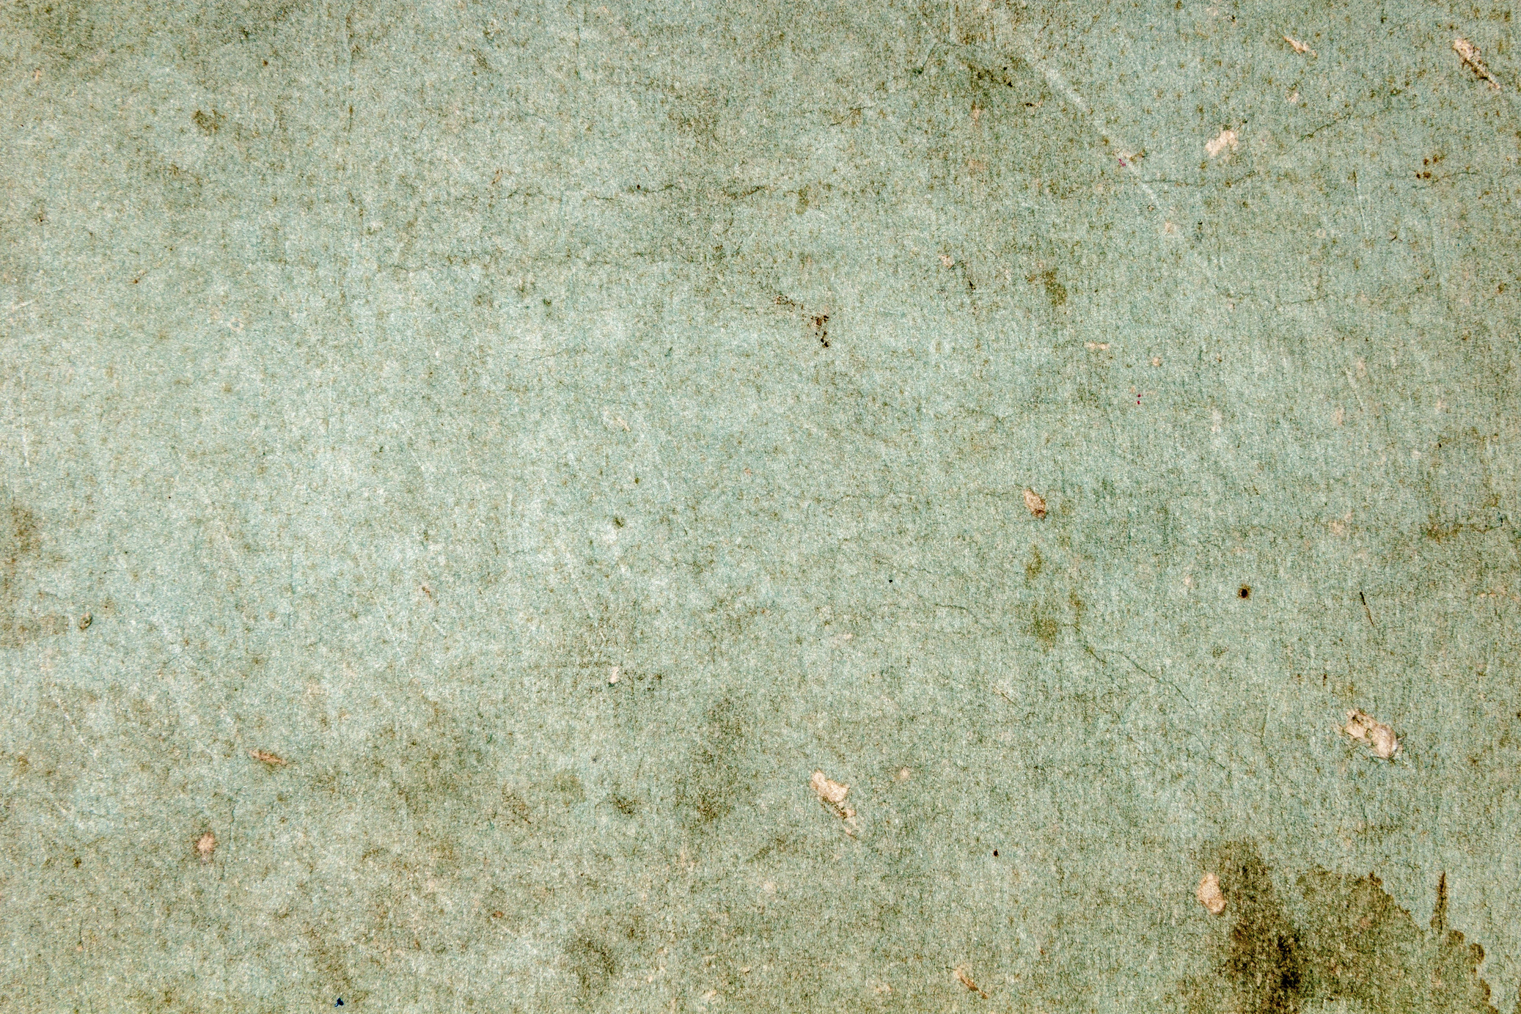


Travel & Enjoy

Slide 2
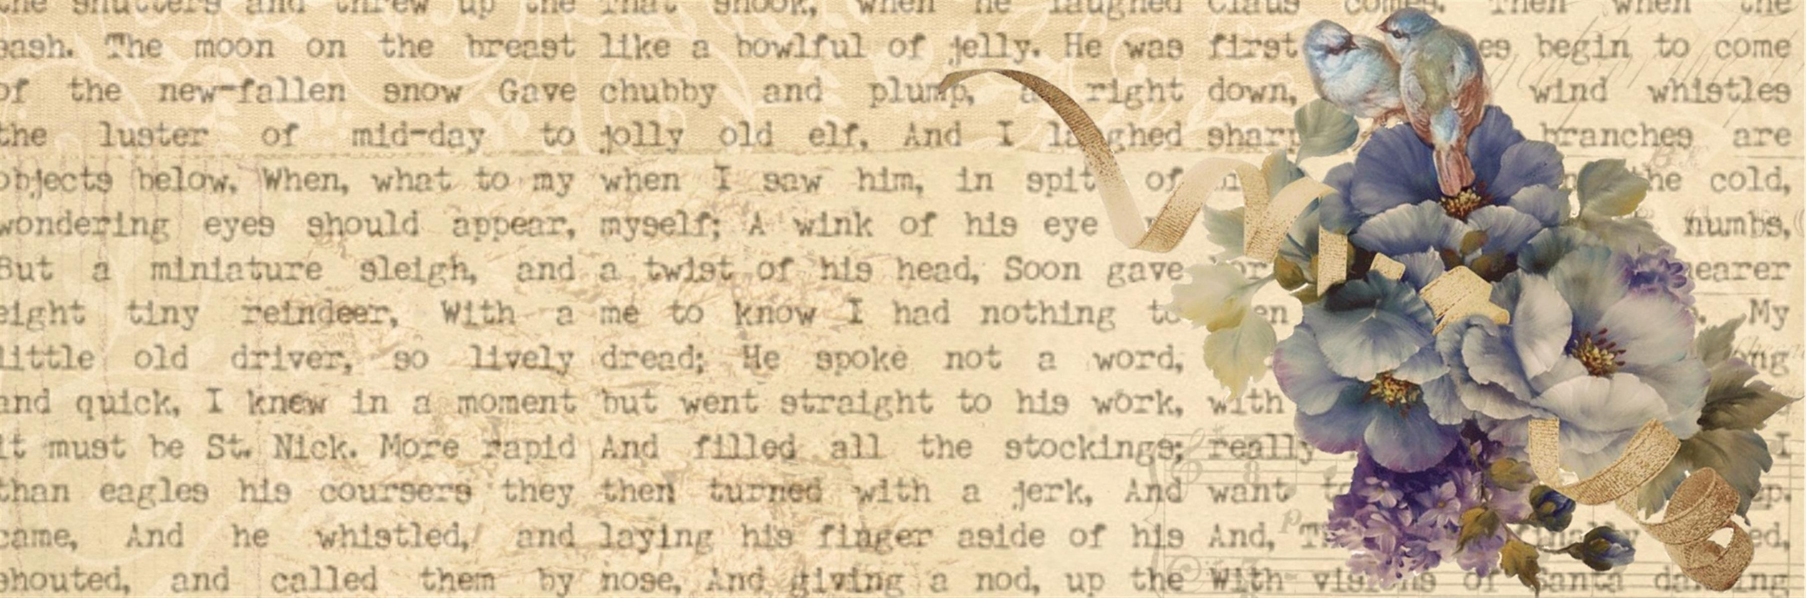


Travel Application
Goal
create your account
See the world
Add your journey
Contact us

Slide 3

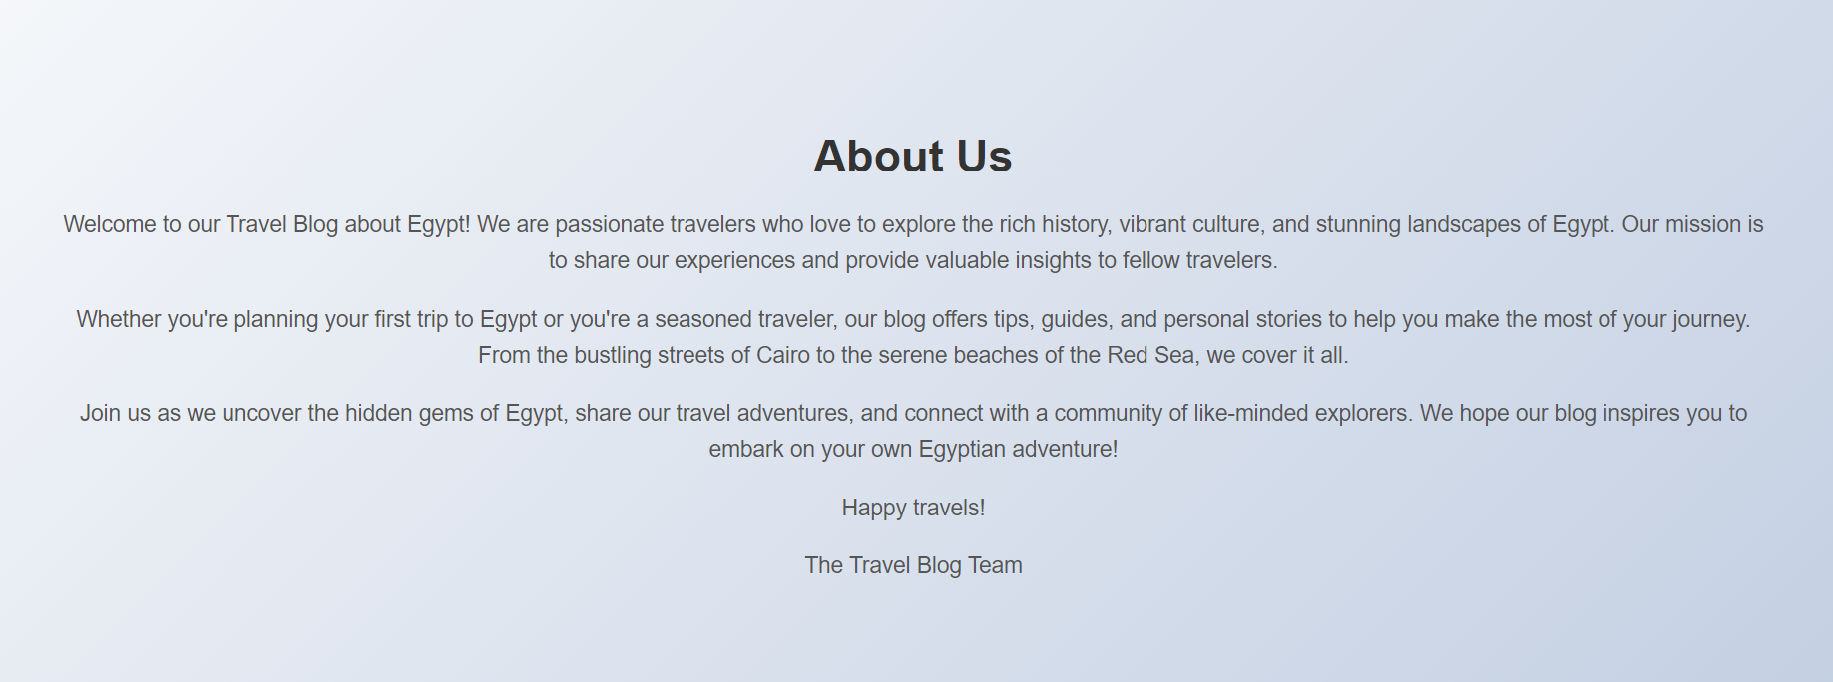
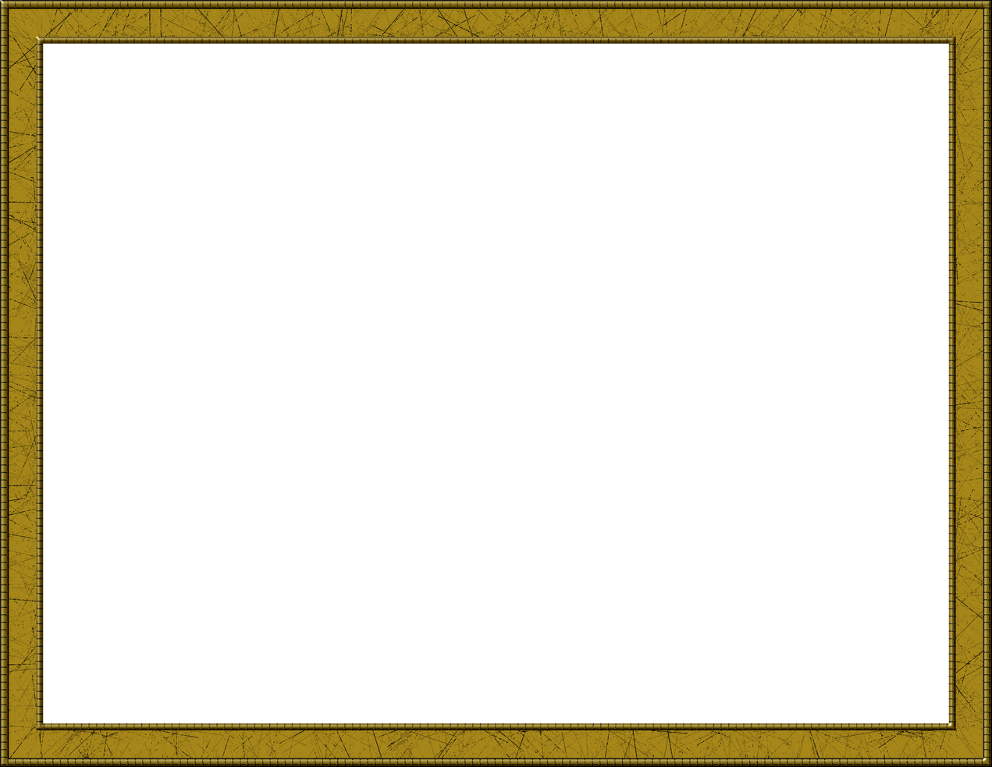
Goal
our Travel Blog about Egypt! We are passionate travelers who love to explore the rich history, and stunning landscapes of Egypt. Our mission is to share our experiences and provide valuable insights to fellow travelers.

Slide 4

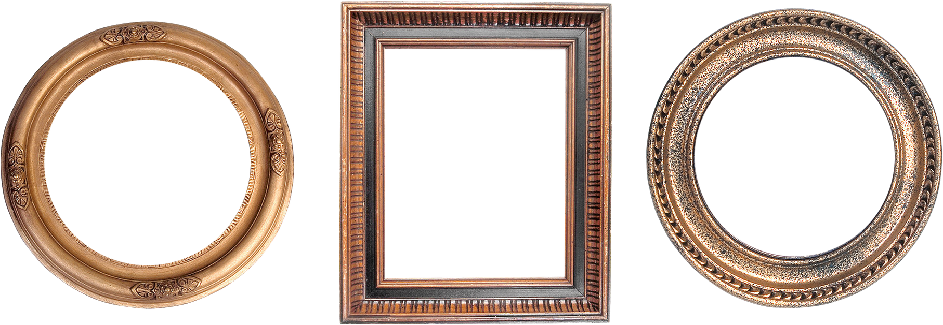

Create you account
Register your information
Register your email

Slide 5


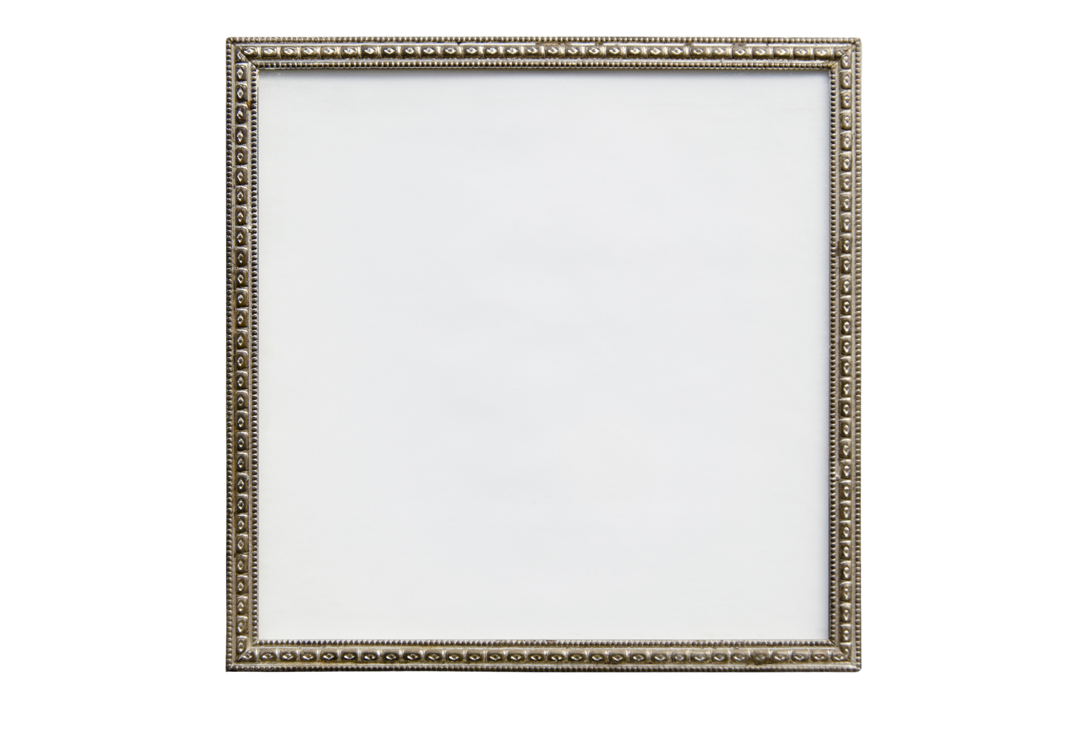
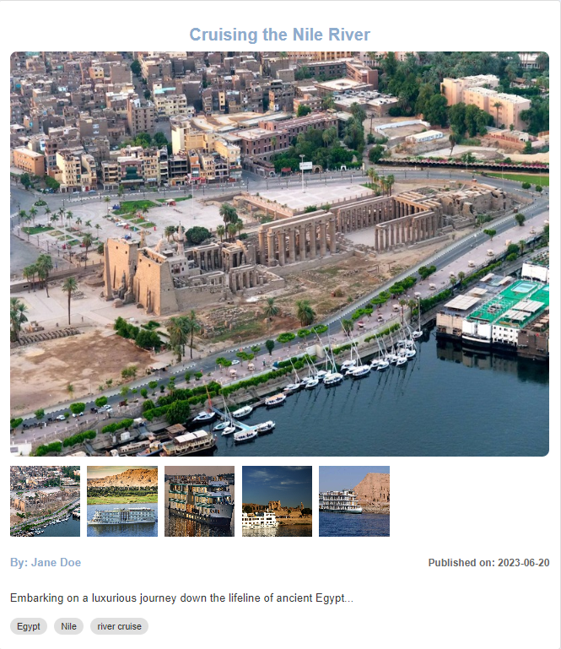
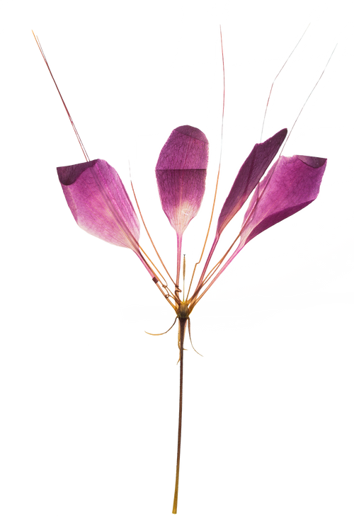
See the world
Share the journey of others
The place
Expressive images
Date of the journey

Slide 6
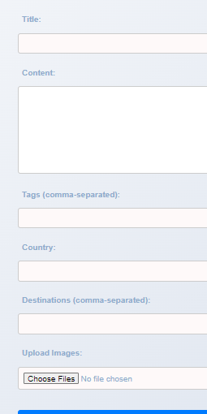
Add your journey
Share your journey
The place
Expressive images
Date of the journey

Slide 7

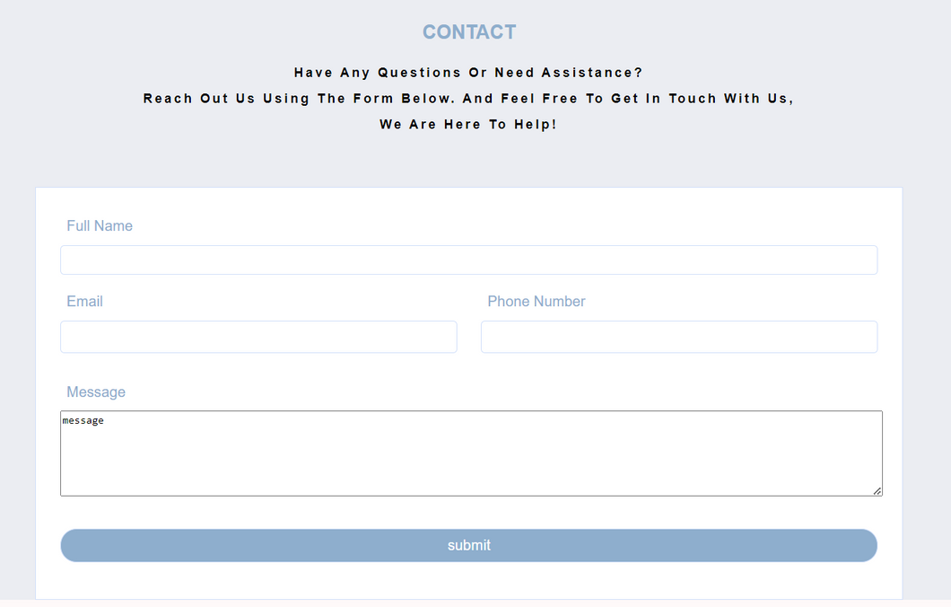
we are here to help!
Contact us
have any questions or need assistance?

Slide 8
Thank
you

